Slide 1
Midterm Project
ITI516 영상처리

Slide 2
Objective
Implement and test a JPEG encoder and decoder
Observe and report the results
Check the results of each encoding step
Visualize the DCT coefficients
Compute the performance in different Quality Factors
Compare the results with OpenCV

Slide 3
Encoding steps (ignore header and Huffman table)
Read an image in grayscale
Process 3-8 for each 8x8 sub-images (blocks)
Shift the intensity level
Forward Discrete Cosine Transform
Quantize
Scan in zigzag order
Run-length encoding
Huffman coding

Slide 4
Decoding steps (inverse steps of Encoding)
Huffman decoding on the data
Deconstruct RLE
Re-order in zigzag order
Dequantize
Inverse Discrete Cosine Transform
Shift the intensity level
Merge the 8x8 sub-images (blocks)
Compare with the original image

Slide 5
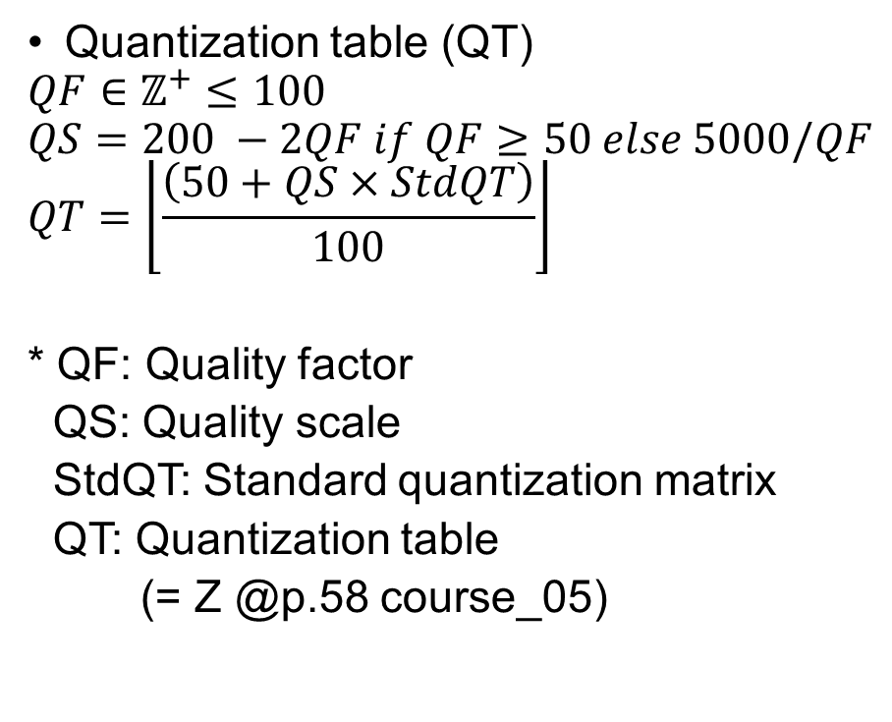
5. Quantize
Standard quantization matrix (StdQT)
np.array([
16, 11, 10, 16, 24, 40, 51, 61, \
12, 12, 14, 19, 26, 58, 60, 55, \
14, 13, 16, 24, 40, 57, 69, 56, \
14, 17, 22, 29, 51, 87, 80, 62, \
18, 22, 37, 56, 68, 109, 103, 77, \
24, 35, 55, 64, 81, 104, 113, 92, \
49, 64, 78, 87, 103, 121, 120, 101, \
72, 92, 95, 98, 112, 100, 103, 99
], dtype=int).reshape([BLOCK_SIZE, BLOCK_SIZE])
Quantization table (QT)
$$QF∈ℤ^{+}≤100$$
$$QS=200 −2QF if QF≥50 else 5000/QF$$
$$QT=\left\lfloor \frac{\left(50+QS×StdQT\right)}{100}\right\rfloor$$
* QF: Quality factor
QS: Quality scale
StdQT: Standard quantization matrix
QT: Quantization table
(= Z @p.58 course_05)
.

Slide 6
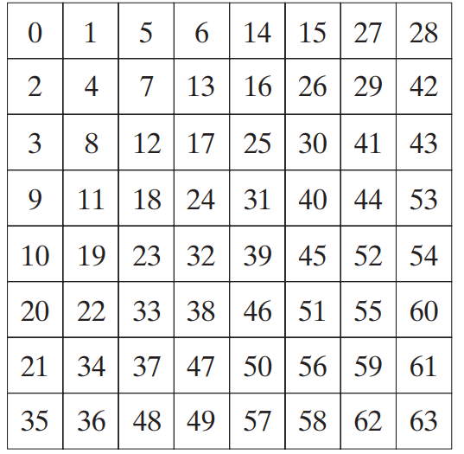
6. Scan in zigzag order
ZIGZAG ORDER
np.array([
0,1,8,16,9,2,3,10, \
17,24,32,25,18,11,4,5, \
12,19,26,33,40,48,41,34, \
27,20,13,6,7,14,21,28, \
35,42,49,56,57,50,43,36, \
29,22,15,23,30,37,44,51, \
58,59,52,45,38,31,39,46, \
53,60,61,54,47,55,62,63
])

Slide 7
7. RLE
DC components
dDC[i] = DC[i] – DC[i-1] if i > 0 else dDC[i] = DC[i]
Code (size=int(dDC[i]).bit_length(), value=dDC[i])
AC components
Code (#zeros to skip, size) (non-zero value)
“EOB” (End-of-Block) denoted by (0, 0)

Slide 8
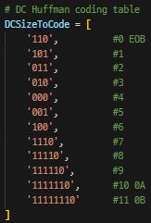
8. Huffman coding
DC components
dDC[i] = DC[i] – DC[i-1] if i > 0 else dDC[i] = DC[i]
Code (size=int(dDC[i]).bit_length(), value=dDC[i])
AC components
Code (#zeros to skip, size) (non-zero value)
“EOB” (End-of-Block) denoted by (0, 0)
Symbol: (#zeros to skip, size)

Slide 9
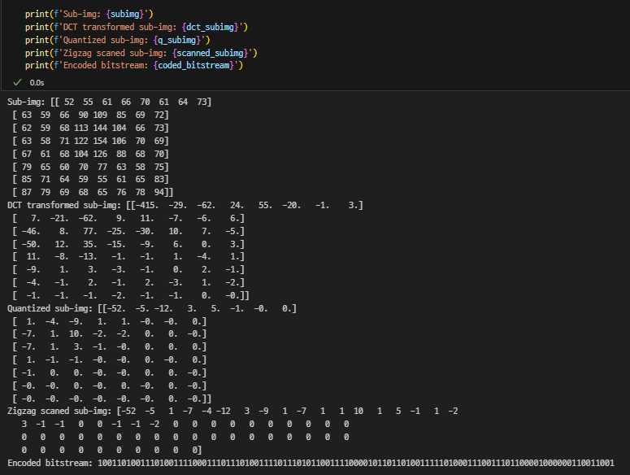
Example 8.17 @p.56 in course_05

Slide 10
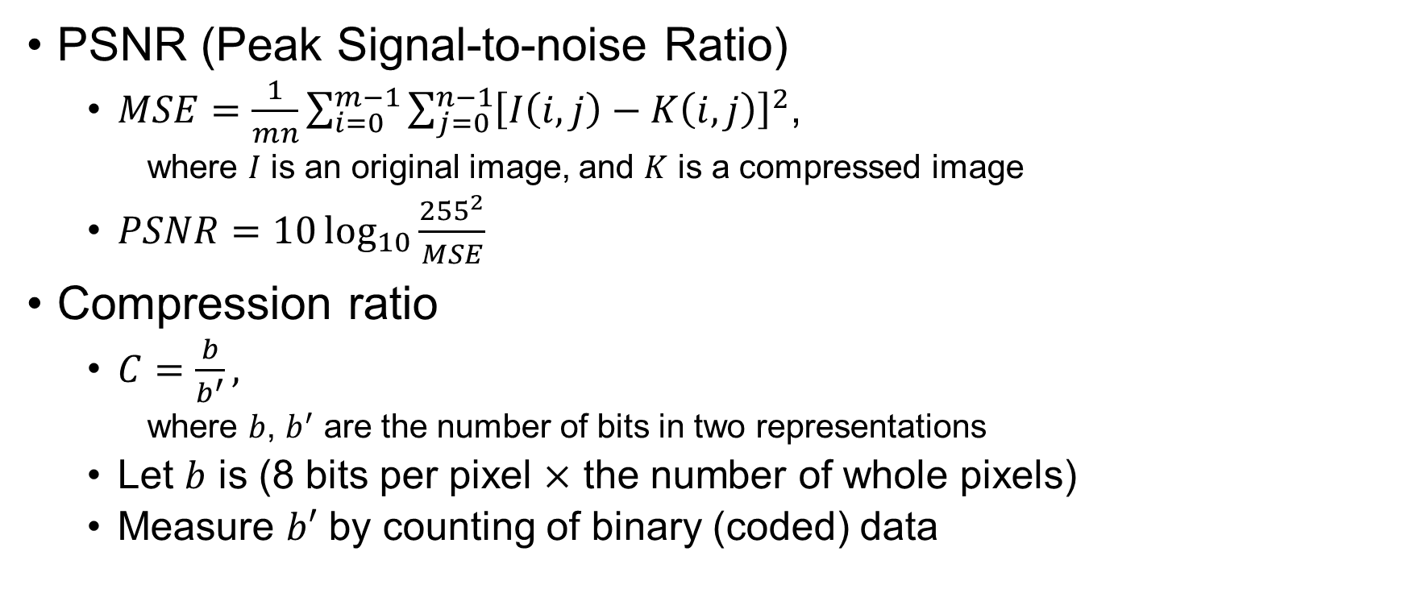
Compute the performance
PSNR (Peak Signal-to-noise Ratio)
$MSE=\frac{1}{mn}\sum_{i=0}^{m−1}{\sum_{j=0}^{n−1}{{\left[I\left(i,j\right)−K\left(i, j\right)\right]}^{2}}}$,
where $I$ is an original image, and $K$ is a compressed image
$PSNR=10\log_{10}{\frac{{255}^{2}}{MSE}}$
Compression ratio
$C=\frac{b}{b^{′}},$
where $b$, $b^{′}$ are the number of bits in two representations
Let $b$ is (8 bits per pixel $×$ the number of whole pixels)
Measure $b′$ by counting of binary (coded) data

Slide 11
Test sub-image
subimg = np.array([
[ 36, 36, 32, 48, 64, 111, 139, 140],
[ 37, 44, 35, 60, 71, 146, 189, 180],
[ 51, 65, 48, 83, 74, 134, 175, 160],
[ 47, 40, 41, 107, 73, 132, 172, 160],
[ 63, 56, 61, 140, 66, 133, 170, 160],
[ 74, 71, 86, 155, 61, 136, 169, 149],
[ 54, 63, 100, 168, 67, 131, 144, 150],
[ 25, 37, 72, 121, 54, 78, 131, 135]
])

Slide 12
Submission
Due: 29th APR, 18:00
Submit a PDF file (report)
File name: ITI516_studentID_name.pdf
(ex. ITI516_2023021185_이경헌.pdf)
Report should include the results of below:
Our codes (Screenshots or typings)
Results of DCT, Quantization, and E.C. for the test sub-image
Visualize the DCT coefficients for “lena.png”
Performance (PSNR and Compression ratio) of yours and OpenCV for “lena.png” and “kodim21.png” in QF = {1, 5, 32, 75}
Delay policy
After the deadline, only 80% per day is accepted.
After 7 days from the deadline, 0 points.

